Slide 1
Discrete Mathematics and Its Application 7th edition, 2001
Kenneth H. Rosen

Slide 2
Welcome to Discrete Mathematics Spring 2018
Instructor: Niu Shao Zhang

Slide 3
§4.3 Primes and Greatest Common Divisors
Section Summary
Prime Numbers and their Properties
Conjectures and Open Problems About Primes
Greatest Common Divisors and Least Common Multiples
The Euclidian Algorithm
gcds as Linear Combinations

Slide 4
Primes
Definition: A positive integer p greater than 1 is called prime if the only positive factors of p are 1 and p. A positive integer that is greater than 1 and is not prime is called composite.
Example: The integer 7 is prime because its only positive factors are 1 and 7, but 9 is composite because it is divisible by 3.

Slide 5
Prime Numbers
An integer p>1 is prime iff it is not the product of two integers greater than 1: p>1 ∧ ¬∃a,b∈N: a>1, b>1, ab=p.
The only positive factors of a prime p are 1 and p itself. Some primes: 2,3,5,7,11,13...
Non-prime integers greater than 1 are called composite, because they can be composed by multiplying two integers greater than 1.

Slide 6
Review
a|b ⇔ “a divides b” ⇔ ∃c∈Z: b=ac
“p is prime” ⇔ p>1 ∧ ¬∃a∈N: (1 < a < p ∧ a|p)
Terms factor, divisor, multiple, composite.

Slide 7
Fundamental Theorem of Arithmetic
Its "Prime Factorization"
Every positive integer has a unique representation as the product of a non-decreasing series of zero or more primes.
Some examples:
1 = (product of empty series) = 1
2 = 2 (product of series with one element 2)
4 = 2·2 (product of series 2,2)
2000 = 2·2·2·2·5·5·5; 2001 = 3·23·29; 2002 = 2·7·11·13; 2003 = 2003 (no clear pattern!)
Later, we will see how to rigorously prove the Fundamental Theorem of Arithmetic, starting from scratch!

Slide 8
The Fundamental Theorem of Arithmetic
Theorem: Every positive integer greater than 1 can be written uniquely as a prime or as the product of two or more primes where the prime factors are written in order of nondecreasing size.
Examples:
100 = 2 ∙ 2 ∙ 5 ∙ 5 = 2² ∙ 5²
641 = 641
999 = 3 ∙ 3 ∙ 3 ∙ 37 = 3³ ∙ 37
1024 = 2 ∙ 2 ∙ 2 ∙ 2 ∙ 2 ∙ 2 ∙ 2 ∙ 2 ∙ 2 ∙ 2 = 2¹⁰

Slide 9


Uniqueness of Prime Factorization
We will prove that a prime factorization of a positive integer where the primes are in nondecreasing order is unique. (This part of the fundamental theorem of arithmetic. The other part, which asserts that every positive integer has a prime factorization into primes, will be proved in Section 5.2.)
Proof: (by contradiction) Suppose that the positive integer n can be written as a product of primes in two distinct ways:
n = p₁p₂ ∙∙∙ p_{s} and n = q₁q₂ ∙∙∙ p_{t}.
Remove all common primes from the factorizations to get
By Lemma 3, it follows that divides , for some k, contradicting the assumption that and are distinct primes.
Hence, there can be at most one factorization of n into primes in nondecreasing order.

Slide 10
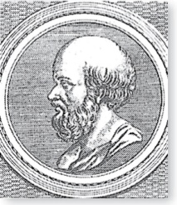
The Sieve of Erastosthenes 埃拉托斯特尼筛选法
Erastothenes
(276-194 B.C.)
The Sieve of Erastosthenes can be used to find all primes not exceeding a specified positive integer. For example, begin with the list of integers between 1 and 100.
Delete all the integers, other than 2, divisible by 2.
Delete all the integers, other than 3, divisible by 3.
Next, delete all the integers, other than 5, divisible by 5.
Next, delete all the integers, other than 7, divisible by 7.
Since all the remaining integers are not divisible by any of the previous integers, other than 1, the primes are:
{2,3,7,11,19,23,29,31,37,41,43,47,53,59,61,67,71,73,79,83,89, 97}
continued →

Slide 11
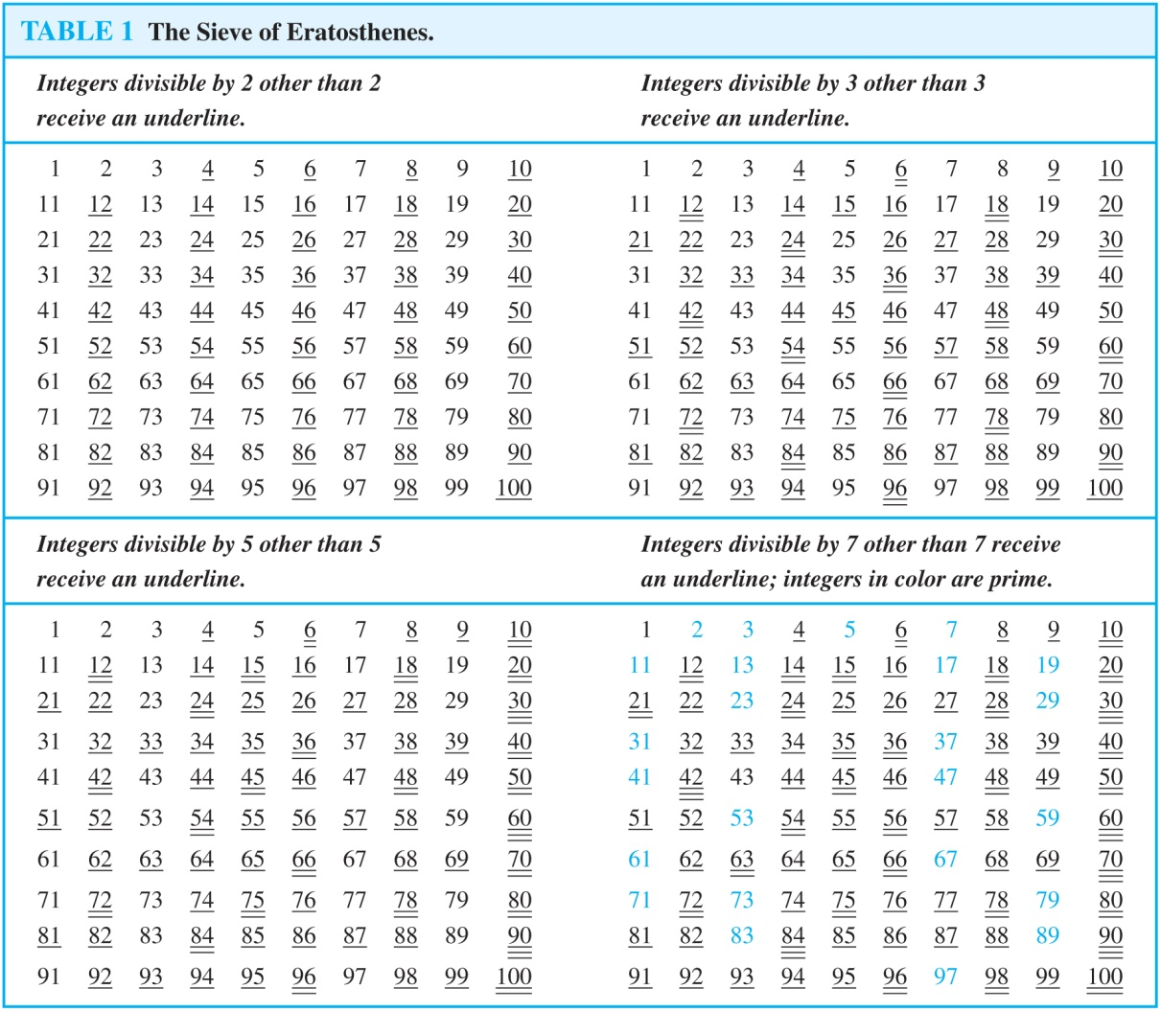
The Sieve of Erastosthenes

Slide 12
Theorem 2
If n is a composite integer, then n has a prime divisor less than or equal to .
Proof：Note that if n = ab, then a ≤ √n or b ≤√n.
Trial division, a very inefficient method of determining if a number n is prime, is to try every integer i ≤√n and see if n is divisible by i.

Slide 13
Theorem 3
There are infinitely many primes.
We assume that there is a largest prime number. Call it p.
Hence, the set of all primes lie between 1 and p.
Form the product of these primes:
r = 2•3•5•7•11•....•p.
But r + 1 is a prime larger than p. (Why?).
This contradicts the assumption that there is a largest prime.
Mersenne primes

Slide 14
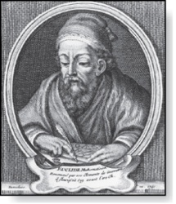
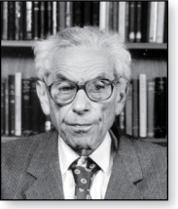
Infinitude of Primes
Euclid
(325 B.C.E. – 265 B.C.E.)
Theorem: There are infinitely many primes. (Euclid)
Proof: Assume finitely many primes: p₁, p₂, ….., p_{n}
Let q = p₁p₂∙∙∙ p_{n} + 1
Either q is prime or by the fundamental theorem of arithmetic it is a product of primes.
But none of the primes p_{j} divides q since if p_{j} | q, then p_{j} divides q − p₁p₂∙∙∙ p_{n} = 1 .
Hence, there is a prime not on the list p₁, p₂, ….., p_{n}. It is either q, or if q is composite, it is a prime factor of q. This contradicts the assumption that p₁, p₂, ….., p_{n} are all the primes.
Consequently, there are infinitely many primes.
This proof was given by Euclid The Elements. The proof is considered to be one of the most beautiful in all mathematics. It is the first proof in The Book, inspired by the famous mathematician Paul Erdős’ imagined collection of perfect proofs maintained by God.
Paul Erdős
(1913-1996)

Slide 15
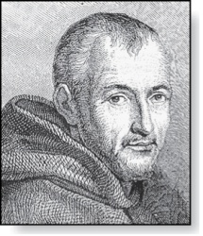
Mersenne Primes
Marin Mersenne
(1588-1648)
Definition: Prime numbers of the form 2^{p} − 1 , where p is prime, are called Mersenne primes.
2² − 1 = 3, 2³ − 1 = 7, 2⁵ − 1 = 37 , and 2⁷ − 1 = 127 are Mersenne primes.
2¹¹ − 1 = 2047 is not a Mersenne prime since 2047 = 23∙89.
There is an efficient test for determining if 2^{p} − 1 is prime.
The largest known prime numbers are Mersenne primes.
As of mid 2011, 47 Mersenne primes were known, the largest is 2^{43,112,609} − 1, which has nearly 13 million decimal digits.
The Great Internet Mersenne Prime Search (GIMPS) is a distributed computing project to search for new Mersenne Primes.
http://www.mersenne.org/

Slide 16
Distribution of Primes
Mathematicians have been interested in the distribution of prime numbers among the positive integers. In the nineteenth century, the prime number theorem was proved which gives an asymptotic estimate for the number of primes not exceeding x.
Prime Number Theorem: The ratio of the number of primes not exceeding x and x/ln x approaches 1 as x grows without bound. (ln x is the natural logarithm of x)
The theorem tells us that the number of primes not exceeding x, can be approximated by x/ln x.
The odds that a randomly selected positive integer less than n is prime are approximately (n/ln n)/n = 1/ln n.

Slide 17
Theorem 4
The prime number theorem
The ratio of the number of primes not exceeding x and x/lnx approaches 1 as x grows without bound.
不超过x的素数个数与x/lnx 的比例趋于1，即不超过x的素数个数约为x/lnx
因此，一个随机选取的正整数n，n为素数的概率为
(n/lnn ) / n= 1/lnn, 越大的素数越难找！

Slide 18
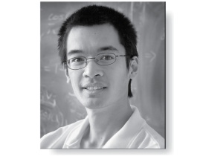
Primes and Arithmetic Progressions (optional)
Euclid’s proof that there are infinitely many primes can be easily adapted to show that there are infinitely many primes in the following 4k + 3, k = 1,2,… (See Exercise 55)
In the 19th century G. Lejuenne Dirchlet showed that every arithmetic progression ka + b, k = 1,2, …, where a and b have no common factor greater than 1 contains infinitely many primes. (The proof is beyond the scope of the text.)
Are there long arithmetic progressions(等差级数) made up entirely of primes?
5,11, 17, 23, 29 is an arithmetic progression of five primes.（d=6）
199, 409, 619, 829, 1039,1249,1459,1669,1879,2089 is an arithmetic progression of ten primes. （d=210）
In the 1930s, Paul Erdős conjectured that for every positive integer n greater than 1, there is an arithmetic progression of length n made up entirely of primes. This was proven in 2006, by Ben Green and Terrence Tau.
Terence Tao
(Born 1975)

Slide 19
Generating Primes
The problem of generating large primes is of both theoretical and practical interest.
So far, no useful closed formula that always produces primes has been found. There is no simple function f(n) such that f(n) is prime for all positive integers n.
But f(n) = n² − n + 41 is prime for all integers 1,2,…, 40. Because of this, we might conjecture that f(n) is prime for all positive integers n. But f(41) = 41² is not prime.
More generally, there is no polynomial with integer coefficients such that f(n) is prime for all positive integers n. (See supplementary Exercise 23.)
Fortunately, we can generate large integers which are almost certainly primes. See Chapter 7.

Slide 20
Least Common Multiple
lcm(a,b) of positive integers a, b, is the smallest positive integer that is a multiple both of a and of b. E.g. lcm(6,10)=30
m = lcm(a,b) = min(m: a|m ∧ b|m) ⇔ a|m ∧ b|m ∧ ∀n∈Z: (a|n ∧ b|n) → (m ≤ n)
If the prime factorizations are written as and , then the LCM is given by

Slide 21
Conjectures about Primes
Even though primes have been studied extensively for centuries, many conjectures about them are unresolved, including:
Goldbach’s Conjecture: Every even integer n, n > 2, is the sum of two primes. It has been verified by computer for all positive even integers up to 1.6 ∙10¹⁸. The conjecture is believed to be true by most mathematicians.
There are infinitely many primes of the form n² + 1, where n is a positive integer. But it has been shown that there are infinitely many primes of the form n² + 1, where n is a positive integer or the product of at most two primes.
The Twin Prime Conjecture: The twin prime conjecture is that there are infinitely many pairs of twin primes. Twin primes are pairs of primes that differ by 2. Examples are 3 and 5, 5 and 7, 11 and 13, etc. The current world’s record for twin primes (as of mid 2011) consists of numbers 65,516,468,355∙23^{33,333} ±1, which have 100,355 decimal digits.

Slide 22
An Application of Primes!
When you visit a secure web site (https:… address, indicated by padlock icon in IE, key icon in Netscape), the browser and web site may be using a technology called RSA encryption.
This public-key cryptography scheme involves exchanging public keys containing the product pq of two random large primes p and q (a private key) which must be kept secret by a given party.
So, the security of your day-to-day web transactions depends critically on the fact that all known factoring algorithms are intractable!
Note: There is a tractable quantum algorithm for factoring; so if we can ever build big quantum computers, then RSA is not secure.
Notes:
Here

Slide 23
Greatest Common Divisor
The greatest common divisor gcd(a,b) of integers a,b (not both 0) is the largest (most positive) integer d that is a divisor both of a and of b.
d = gcd(a,b) = max(d: d|a ∧ d|b) ⇔ d|a ∧ d|b ∧ ∀e∈Z, (e|a ∧ e|b) → d ≥ e
Example: gcd(24,36)=? Positive common divisors: 1,2,3,4,6,12. The largest one of these is 12.

Slide 24
GCD shortcut
If the prime factorizations are written as and , then the GCD is given by:
Example of using the shortcut:
a=84=2·2·3·7 = 2²·3¹·7¹
b=96=2·2·2·2·2·3 = 2⁵·3¹·7⁰
gcd(84,96) = 2²·3¹·7⁰ = 2·2·3 = 12.

Slide 25
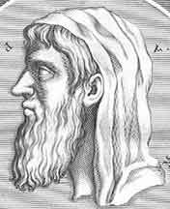
Euclid’s Algorithm for GCD
Finding GCDs by comparing prime factorizations can be difficult when the prime factors are not known!
Euclid discovered: For all ints. a, b, gcd(a, b) = gcd( b, (a mod b)).
Sort a,b so that a>b, and then (given b>1) (a mod b) < b, so problem is simplified.
Euclid of Alexandria 325-265 B.C.

Slide 26
Euclid’s Algorithm Example
gcd(372,164) = gcd(372 mod 164, 164).
372 mod 164 = 372−164⎣372/164⎦ = 372−164·2 = 372−328 = 44.
gcd(164,44) = gcd(164 mod 44, 44).
164 mod 44 = 164−44⎣164/44⎦ = 164−44·3 = 164−132 = 32.
gcd(44,32) = gcd(44 mod 32, 32) = gcd(12, 32) = gcd(32 mod 12, 12) = gcd(8,12) = gcd(12 mod 8, 8) = gcd(4,8) = gcd(8 mod 4, 4) = gcd(0,4) = 4.
Notes:
Have students come up with other examples and work through them. Maybe start with a 2-digit example.

Slide 27
Euclid’s Algorithm Pseudocode
procedure gcd(a, b: positive integers)
while b ≠ 0 begin
r ≔ a mod b; a ≔ b; b ≔ r; end
return a
Sorting inputs not needed b/c order will be reversed each iteration.
Fast! Number of while loop iterations turns out to be O(log(max(a,b))).

Slide 28
Euclidean Algorithm
Euclid
(325 B.C.E. – 265 B.C.E.)
The Euclidian algorithm is an efficient method for computing the greatest common divisor of two integers. It is based on the idea that gcd(a,b) is equal to gcd(a,c) when a > b and c is the remainder when a is divided by b.
Example: Find gcd(91, 287):
287 = 91 ∙ 3 + 14
91 = 14 ∙ 6 + 7
14 = 7 ∙ 2 + 0
gcd(287, 91) = gcd(91, 14) = gcd(14, 7) = 7
Divide 287 by 91
Divide 91 by 14
Divide 14 by 7
Stopping condition
continued →

Slide 29
Euclidean Algorithm
The Euclidean algorithm expressed in pseudocode is:
In Section 5.3, we’ll see that the time complexity of the algorithm is O(log b), where a > b.
procedure gcd(a, b: positive integers)
x := a
x := b
while y ≠ 0
r := x mod y
x := y
y := r
return x {gcd(a,b) is x}

Slide 30
Correctness of Euclidean Algorithm
Lemma 1: Let a = bq + r, where a, b, q, and r are integers. Then gcd(a,b) = gcd(b,r).
Proof:
Suppose that d divides both a and b. Then d also divides a − bq = r (by Theorem 1 of Section 4.1). Hence, any common divisor of a and b must also be any common divisor of b and r.
Suppose that d divides both b and r. Then d also divides bq + r = a. Hence, any common divisor of a and b must also be a common divisor of b and r.
Therefore, gcd(a,b) = gcd(b,r).

Slide 31
Correctness of Euclidean Algorithm
Suppose that a and b are positive
integers with a ≥ b.
Let r₀ = a and r₁ = b.
Successive applications of the division
algorithm yields:
Eventually, a remainder of zero occurs in the sequence of terms: a = r₀ > r₁ > r₂ > ∙ ∙ ∙ ≥ 0. The sequence can’t contain more than a terms.
By Lemma 1
gcd(a,b) = gcd(r₀,r₁) = ∙ ∙ ∙ = gcd(r_{n-1},r_{n}) = gcd(r_{n} , 0) = r_{n}.
Hence the greatest common divisor is the last nonzero remainder in the sequence of divisions.
r₀ = r₁q₁ + r₂ 0 ≤ r₂ < r₁,
r₁ = r₂q₂ + r₃ 0 ≤ r₃ < r₂,
∙
∙
∙
r_{n-2} = r_{n-1}q_{n-1} + r₂ 0 ≤ r_{n} < r_{n-1},
r_{n-1} = r_{n}q_{n} .

Slide 32
Relative Primality
Integers a and b are called relatively prime or coprime iff their gcd = 1.
Example: Neither 21 nor 10 is prime, but they are coprime. 21=3·7 and 10=2·5, so they have no common factors > 1, so their gcd = 1.
A set of integers {a₁,a₂,…} is (pairwise) relatively prime if all pairs (a_{i}, a_{j}), for i≠j, are relatively prime.
Example: 10,17,21

Slide 33
Theorem 5
Let a and b be positive Integers. Then ab=gcd(a,b) · lcm(a,b)

Slide 34
Greatest Common Divisor
BÉZOUT’S THEOREM （贝祖定理）
If a and b are positive integers, then there exist integers s and t such that gcd(a, b) = sa + tb.
Definition
If a and b are positive integers, then integers s and t such that gcd(a, b) = sa + tb are called Bézout coefficients of a and b
the equation gcd(a, b) = sa + tb is called Bézout’s identity.
the uniqueness of the prime factorization of a positive integer

Slide 35



EXAMPLE 17
Express gcd(252, 198) = 18 as a linear combination of 252 and 198.(p270)

Slide 36
Consequences of Bézout’s Theorem
Lemma 2: If a, b, and c are positive integers such that gcd(a, b) = 1 and a | bc, then a | c.
Proof: Assume gcd(a, b) = 1 and a | bc
Since gcd(a, b) = 1, by Bézout’s Theorem there are integers s and t such that
sa + tb = 1.
Multiplying both sides of the equation by c, yields sac + tbc = c.
From Theorem 1 of Section 4.1:
a | tbc (part ii) and a divides sac + tbc since a | sac and a|tbc (part i)
We conclude a | c, since sac + tbc = c.
Lemma 3: If p is prime and p | a₁a₂∙∙∙a_{n}, then p | a_{i} for some i.
(proof uses mathematical induction; see Exercise 64 of Section 5.1)
Lemma 3 is crucial in the proof of the uniqueness of prime factorizations.

Slide 37
Dividing Congruences by an Integer
Theorem 7: Let m be a positive integer and let a, b, and c be integers. If ac ≡ bc (mod m) and gcd(c,m) = 1, then a ≡ b (mod m).
Proof: Since ac ≡ bc (mod m), m | ac − bc = c(a − b) by Lemma 2 and the fact that gcd(c,m) = 1, it follows that m | a − b. Hence, a ≡ b (mod m).

Slide 38
Homework
§4.3
16, 24(a,c,f), 30

